Slide 1
ANAS AMANULLAH
Biography

Slide 2
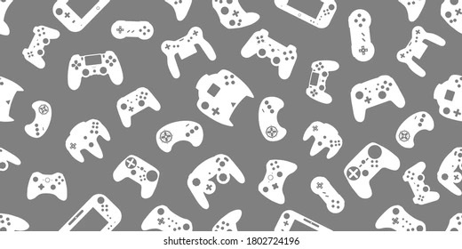
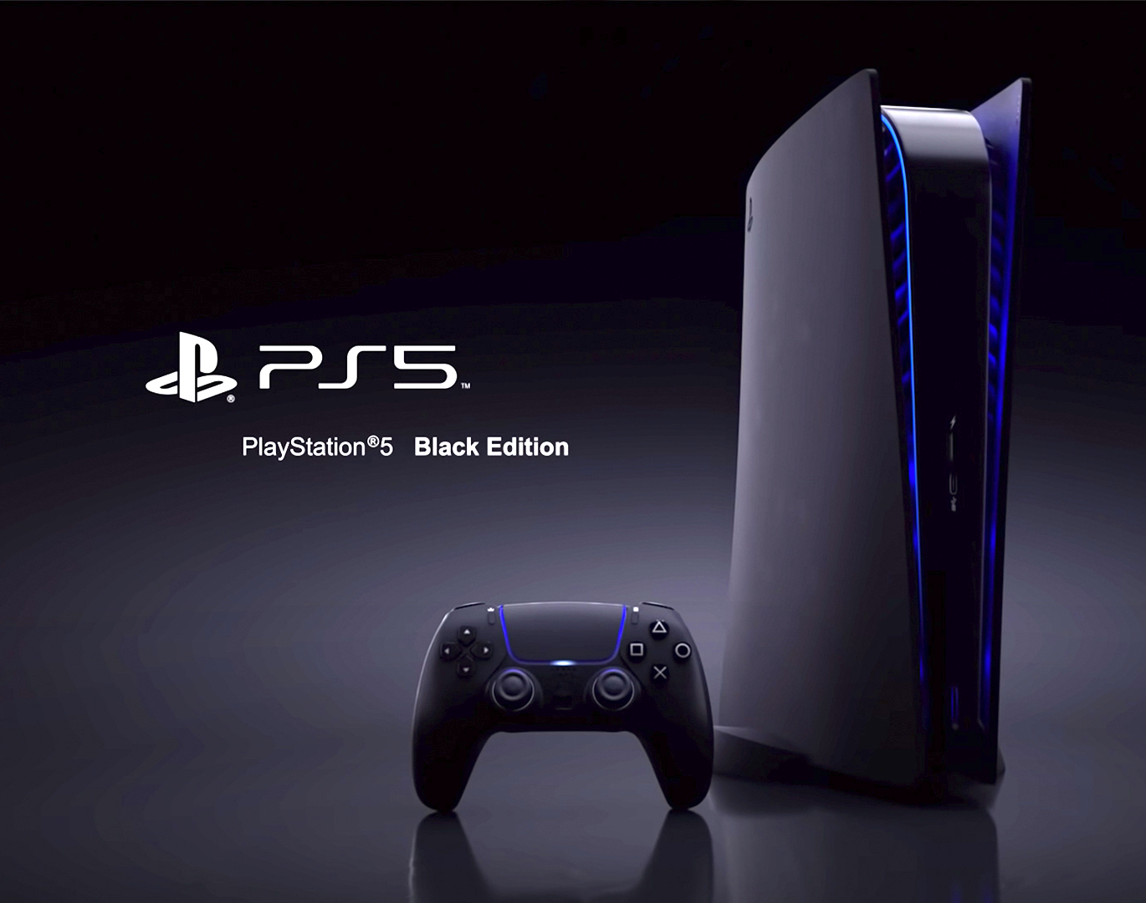
Gaming
Gaming is definetely one of my favourite hobbies .
My favourite console is the Playstation 5 which supports next generation 4K gameplay.
I prefer all sorts of games, but a personal preference would definetely be adventure games.

Slide 3

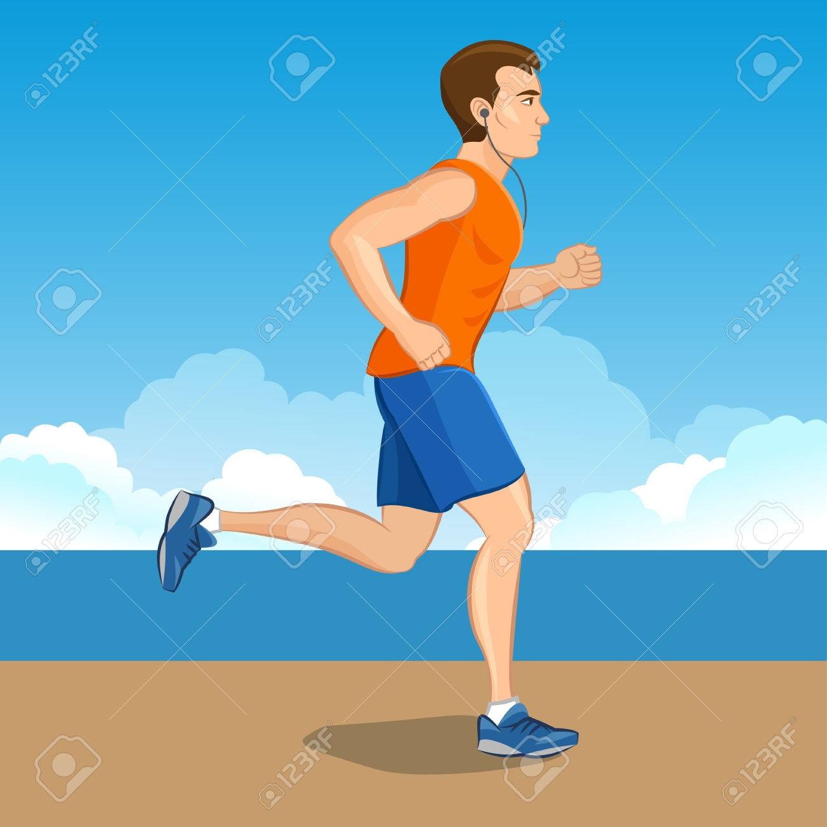
Exercise
My day without exercising is incomplete.
The main form of exercise that I utilise is jogging/running.
I exercise after Maghrib in my neighbourhood park(Rahat Park).
Exercise is really good for the body and it is important to stay fit

Slide 4

Schooling
I did my O levels from Bay View Academy .
My grades were 5As and 5Bs.
I took part in many events in this school
The most memorable part of my journey in this school was the grad trip to Georgia.

Slide 5

A-Levels
I did my A levels from The Lyceum.
I had Accounts, Economics and Mathematics as my elective subjects.
COVID Lockdown really hindered my A Level experience.

Slide 6
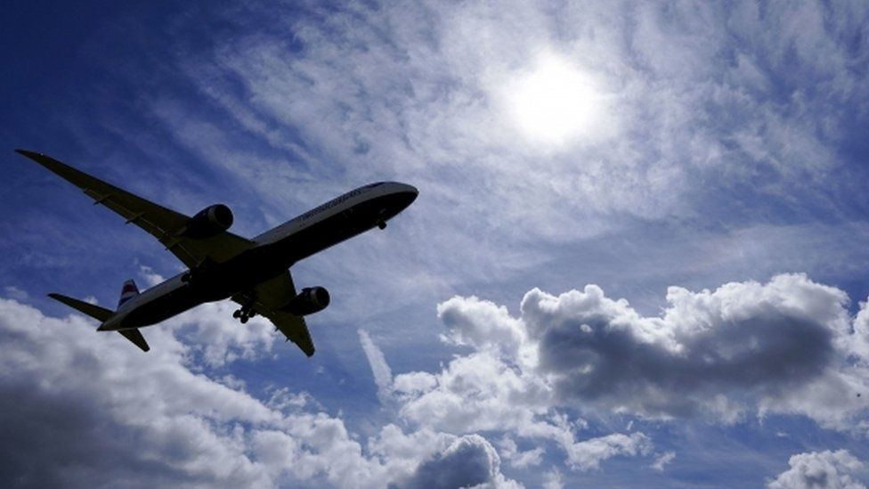
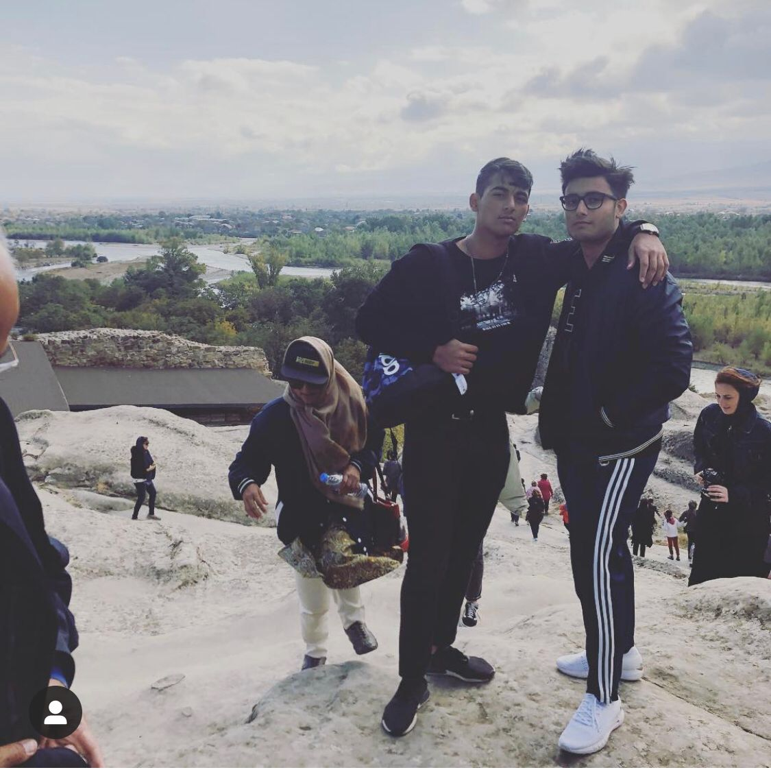
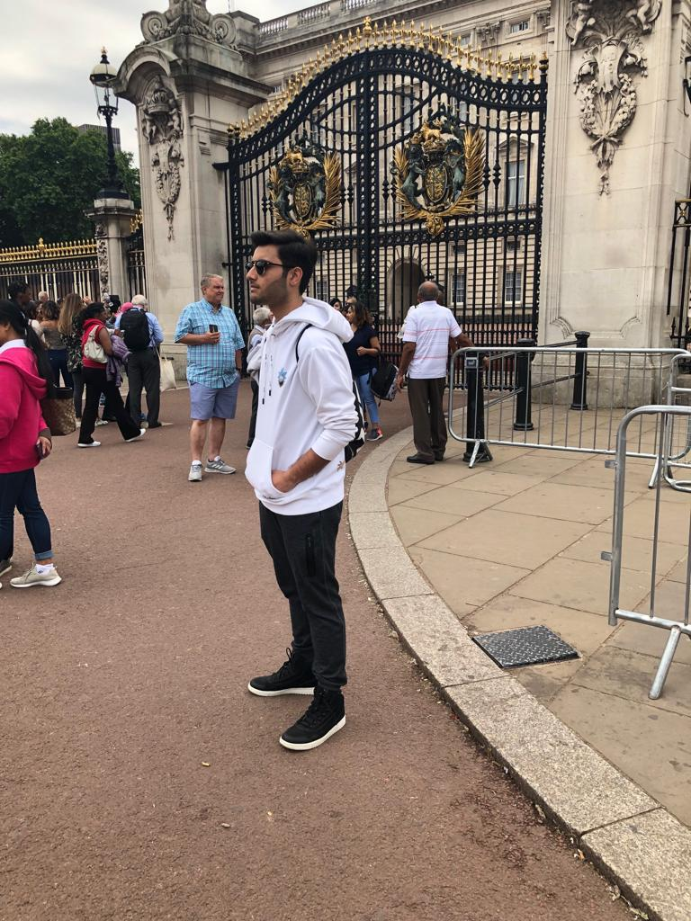
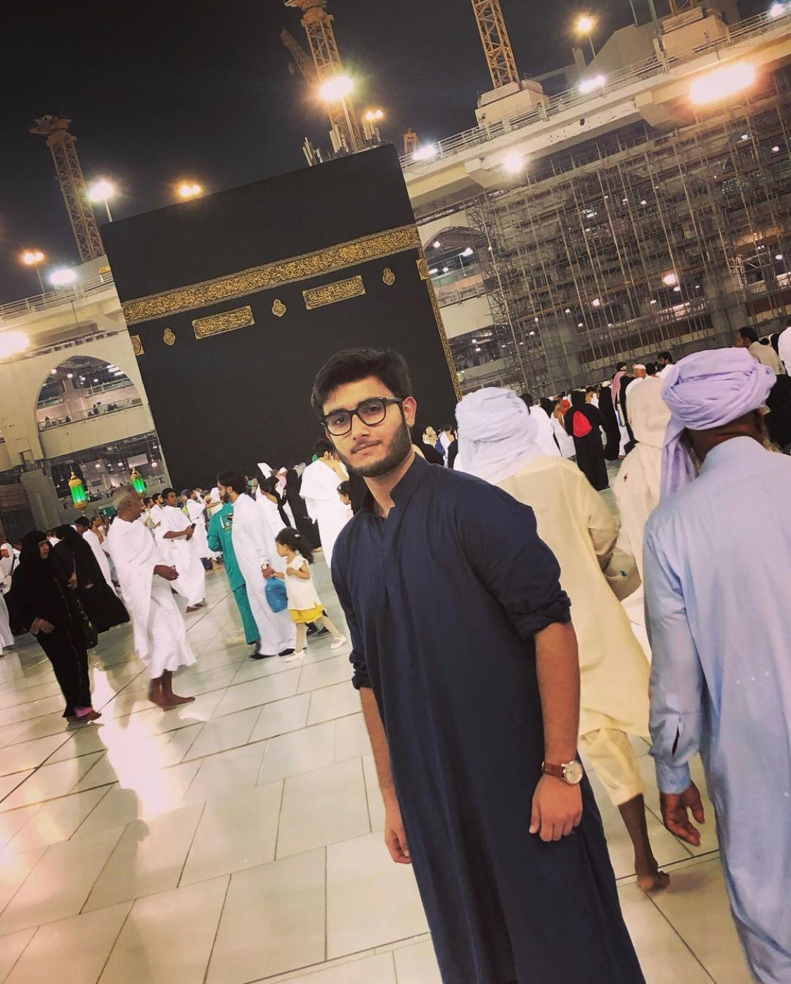
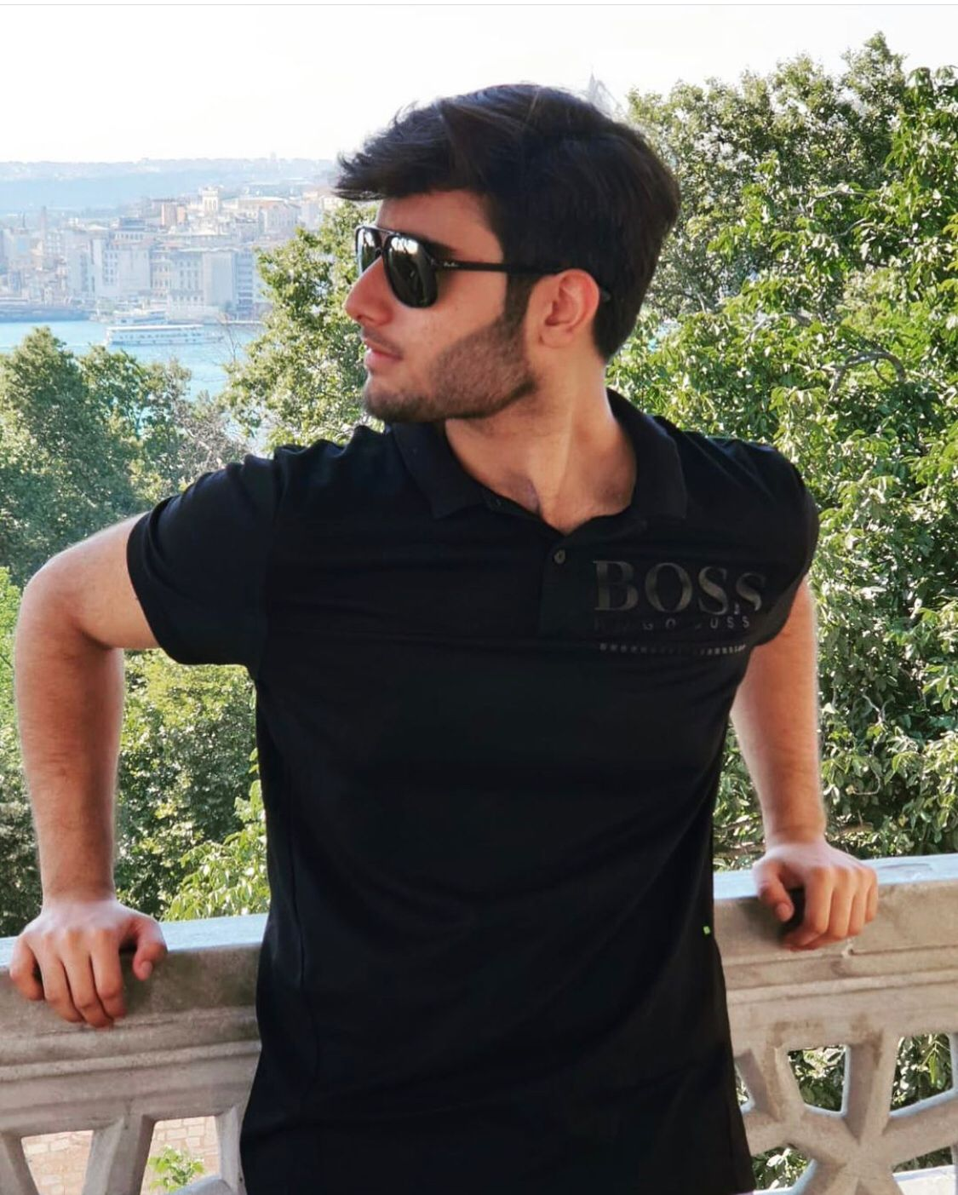
Countries that I have been to
I have been to England, Georgia, Saudi Arabia, UAE, Malaysia, Turkey, Thailand and Bahrain
Saudi Arabia
Turkey
Georgia
England

Slide 7
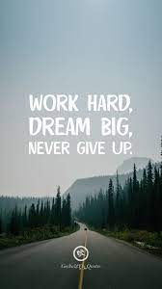
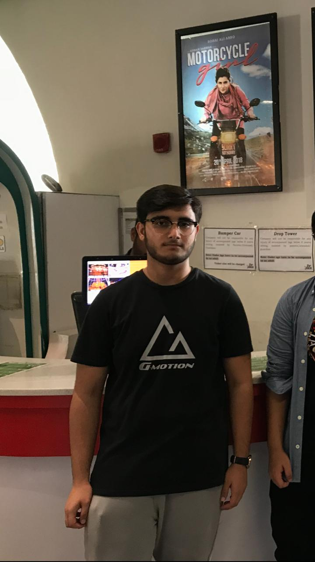
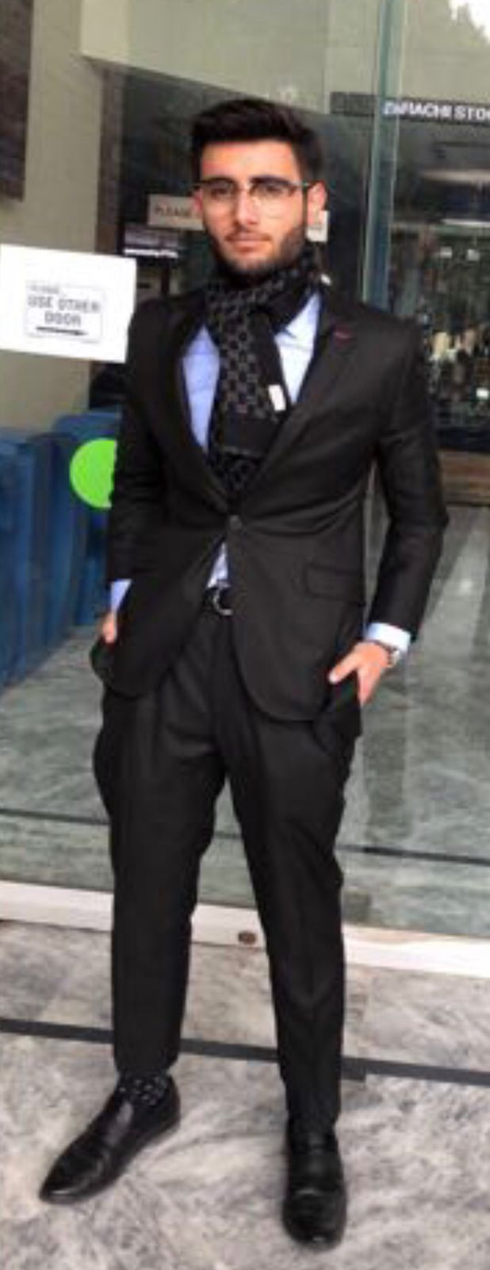
Transformation
Before
After
This is at my heaviest , 97 kg back in 2018 . After which I decided to turn my life around and change myself.
This is after I lost almost 30 kgs, this is me in the beginning of 2020 when I transformed my body completely with hardwork and dedication.I am at my lightest at 69 kg.

Slide 8
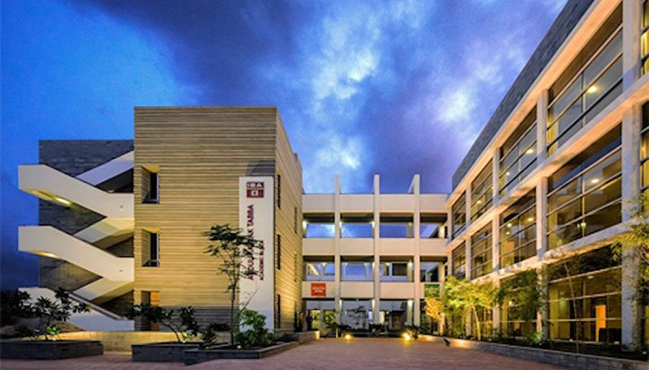
Institute of Business Administration
I am currently pursuing my bachelors in business administration from IBA Karachi.

Slide 9
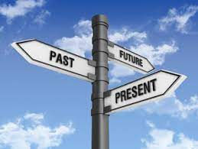

Future Plan
After I am done with my undergraduate degree I plan to go abroad to pursue a masters degree in business administration.
I would like to start a business of my own after I am done with my studies

Slide 10
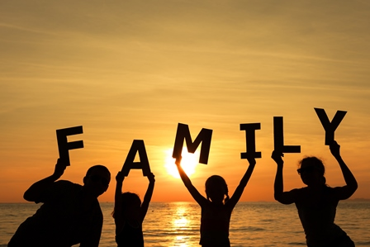
Family
I live with my parents and grandmother and I have one older brother .

Slide 11
THANK YOU
That’s my biography

